Slide 1
UPLIFTING FARMERS THROUGH CONNECTED ECOSYSTEM
VIVA-VOCE
Batch Number: G17
Under the Supervision of,
Ms. Deepthi S
Associate Professor
School of Computer Science & Engineering
Presidency University
Roll Number | Student Name
20211CAI0111 20211CAI0140 20211CAI0149 20211CAI0143 | NIDHI D VIGNESH V ANIL KUMAR S SANDEEP R
Name of the Program: Bachelor of Technology
Name of the HoD: Dr. Zafar Ali Khan N
Name of the Program Project Coordinator: Dr. Afroz Pasha

Slide 2
Introduction
Indian farmers face significant challenges such as middlemen dependence,
limited market access, and inadequate financial services.
These issues hinder productivity, lower incomes, and create inefficiencies in
the agricultural supply chain.
A mobile app is proposed to connect farmers directly with marketplaces,
financial institutions, and expert advisors.
The app promotes sustainable farming practices, ensures inclusivity,
and offers offline access for rural areas.
This initiative supports India’s digital vision and aligns with global
Sustainable Development Goals (SDGs)

Slide 3
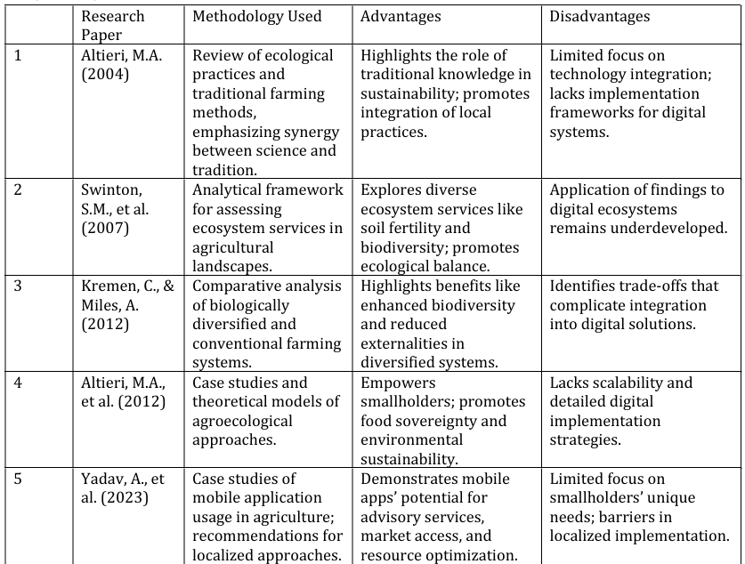
Literature Review

Slide 4
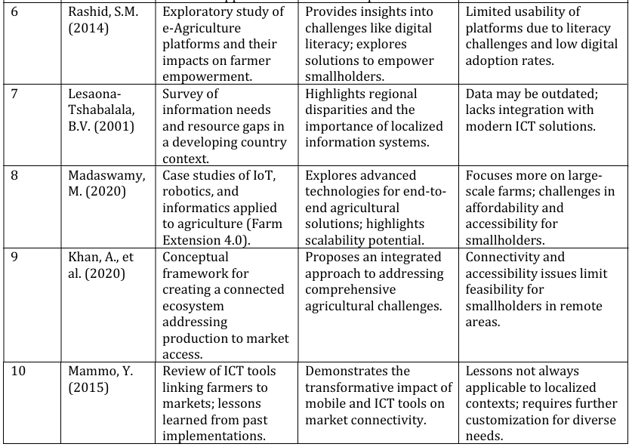
Literature Review contd..

Slide 5
Research Gaps Identified
Sustainability and Ecosystem Services Integration
Localized and Context-Specific Solutions
Digital Accessibility and Farmer Empowerment
Market Linkages and Financial Inclusion
Data-Driven Decision Making
Holistic Integration of Services
Sustainability and Scalability of Solutions

Slide 6
Proposed Method
Problem Identification: Surveys and data analysis focus on issues like middlemen dependency, limited market access, and lack of real-time expert advice.
Requirement Analysis: Android as the primary platform, optimized for low connectivity with multilingual support.
Mobile App Development: User-friendly interface with real-time synchronization via Firebase and secure backend using Node.js and MongoDB.
Ecosystem Services Integration: Direct market linkages, financial services access, and AI-driven expert consultations.
Sustainable Practices: Modules for environmental conservation and tracking soil health, water usage, and biodiversity.

Slide 7
Objectives
Develop a comprehensive digital platform to streamline farming processes, including crop planning, market access, and financial services, while supporting regional and multilingual customization.
Promote farmer empowerment and sustainability by integrating traditional knowledge with ecological methods and providing actionable insights for efficient resource use.
Bridge connectivity and accessibility gaps by creating an affordable, user-friendly platform with offline functionality and voice-guided navigation for low-literacy and low-connectivity regions.

Slide 8
System Design & Implementation
Frontend Development:
Developed using Android Studio with Java and XML for the user interface.
Optimized for minimal data usage and efficient performance on low-end devices.
Features were implemented incrementally, incorporating continuous testing and user feedback.
Backend Development:
Utilized Firebase for real-time data synchronization and hosting.
Integrated APIs for weather and market data using RESTful principles for seamless data flow.
Ensured instant availability of updates, alerts, and notifications.

Slide 9
Implementation Details contd..
Testing and Validation:
Conducted unit testing, integration testing, and user acceptance testing.
A pilot phase with selected farmers provided valuable feedback for refinement.
Enhanced usability, connectivity, and performance based on user input.
Deployment and Monitoring:
Deployed the app on Google Play for public access.
Scaled backend infrastructure to support increasing users.
Implemented real-time monitoring for system performance, user engagement, and error tracking.
Planned regular updates and maintenance to incorporate new features and improve functionality.

Slide 10
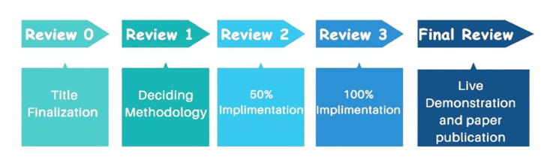
Timeline of Project

Slide 11
Outcomes/Results Obtained
Enhanced Access to Resources and Sustainable Practices The platform connects farmers with expert advice, market data, and financial tools, promoting sustainable farming practices and improving productivity.
Market Linkages and Economic Empowerment Direct access to markets, transparent pricing, and efficient logistics help farmers earn fair compensation and increase their income.
Challenges and Future Enhancements Despite success, challenges like limited internet access remain, and future improvements in scalability, customization, and blockchain integration are needed.

Slide 12
Conclusion
Comprehensive Digital Platform Development The project successfully created an integrated platform that combines advisory support, financial tools, market linkages, and logistics, enhancing operational efficiency and farmer decision-making.
Empowerment Through Sustainable Practices By promoting eco-friendly practices with real-time insights and educational content, the platform encouraged precision irrigation and reduced chemical use, leading to improved crop yields and environmental sustainability.
Bridging Connectivity Gaps The platform addressed digital accessibility with features like multi-language support and offline functionality, though limited internet connectivity remains a challenge that requires further collaboration with telecom providers and governments.

Slide 13
References
[1] Khan, A., Khan, F., & Thakre, P. (2020). Uplifting Farmers Through Connected Ecosystem.
[2] Mohan Kumar, P. (2022). An Outlook on Precision Agriculture Role in Supervision of Small-Scale Crops and Farmers in Remote Areas. In Innovations in Computer Science and Engineering: Proceedings of the Ninth ICSE, 2021 (pp. 165-171). Singapore: Springer Singapore.
[3] Mdoda, L., Christian, M., & Agbugba, I. (2024). Use of Information systems (Mobile phone app) for enhancing smallholder farmers’ Productivity in Eastern Cape Province, South Africa: implications on food security. Journal of the Knowledge Economy, 15(1), 1993-2009.
[4] Choruma, D. J., Dirwai, T. L., Mutenje, M., Mustafa, M., Chimonyo, V. G. P., Jacobs Mata, I., & Mabhaudhi, T. (2024). Digitalisation in agriculture: A scoping review of technologies in practice, challenges, and opportunities for smallholder farmers in sub-saharan africa. Journal of Agriculture and Food Research, 101286.
[5] Kumaravel, K. S., Leonard, L., Baskar, D. C., & Saravanan, S. (2022). Linking farmers with markets through ICT Tools. Agricultural Marketing in India, 23.
[6] Yadav, A., Thilagam, P., & Singh, S. (2023). Mobile applications for agricultural transformation: Types, impacts, case studies, and recommendations.
[7] Kamal, M., & Bablu, T. A. (2023). Mobile applications empowering smallholder farmers: an analysis of the impact on agricultural development. International Journal of Social Analytics, 8(6), 36-52.
[8] Singh, K., Kumar, P., Kalra, V. P., & Singh, D. (2022). Economic, social and behavioral development of farmers through Farmer FIRST Programme in Punjab. Indian Farming, 72(8), 38-41.
[9] Balkrishna, A., Sharma, J., Sharma, H., Mishra, S., Singh, S., Verma, S., & Arya, V. (2021). Agricultural mobile apps used in India: Current status and gap analysis. Agricultural Science Digest-A Research Journal, 41(1), 1-12.
[10] Rey, W. P. Kadiwa Anywhere: A Mobile App Facilitating Produce Exchange Through. In the 2nd International Conference on Cloud Computing and Computer Networks: ICCCN 2024 (p. 113). Springer Nature.

Slide 14
Publication Details
Publication Link:https://ijircce.com/get-current-issue.php?key=MTY1
Or
https://ijircce.com/admin/main/storage/app/pdf/5ddtXPucY25TD9jWHrIHEphrQKbHHn75Z781gHxD.pdf
62nd Paper in International Journal of Innovative Rescarch in Computer and Communication Engineering

Slide 15
Github Link
https://github.com/VigneshVeb/FarmerApp

Slide 16
Thank You

